Slide 1
MapScan
Semantic Segmentation of Satellite Imagery
Rafael Ferreira and Saym Imtiaz

Slide 2
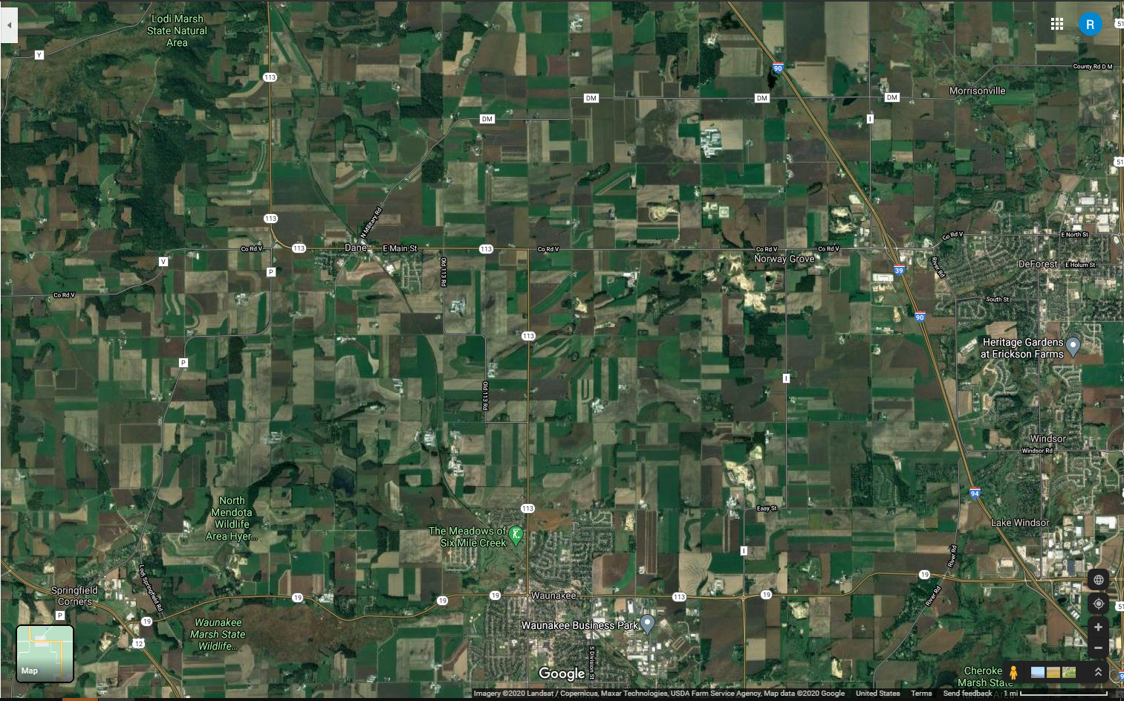
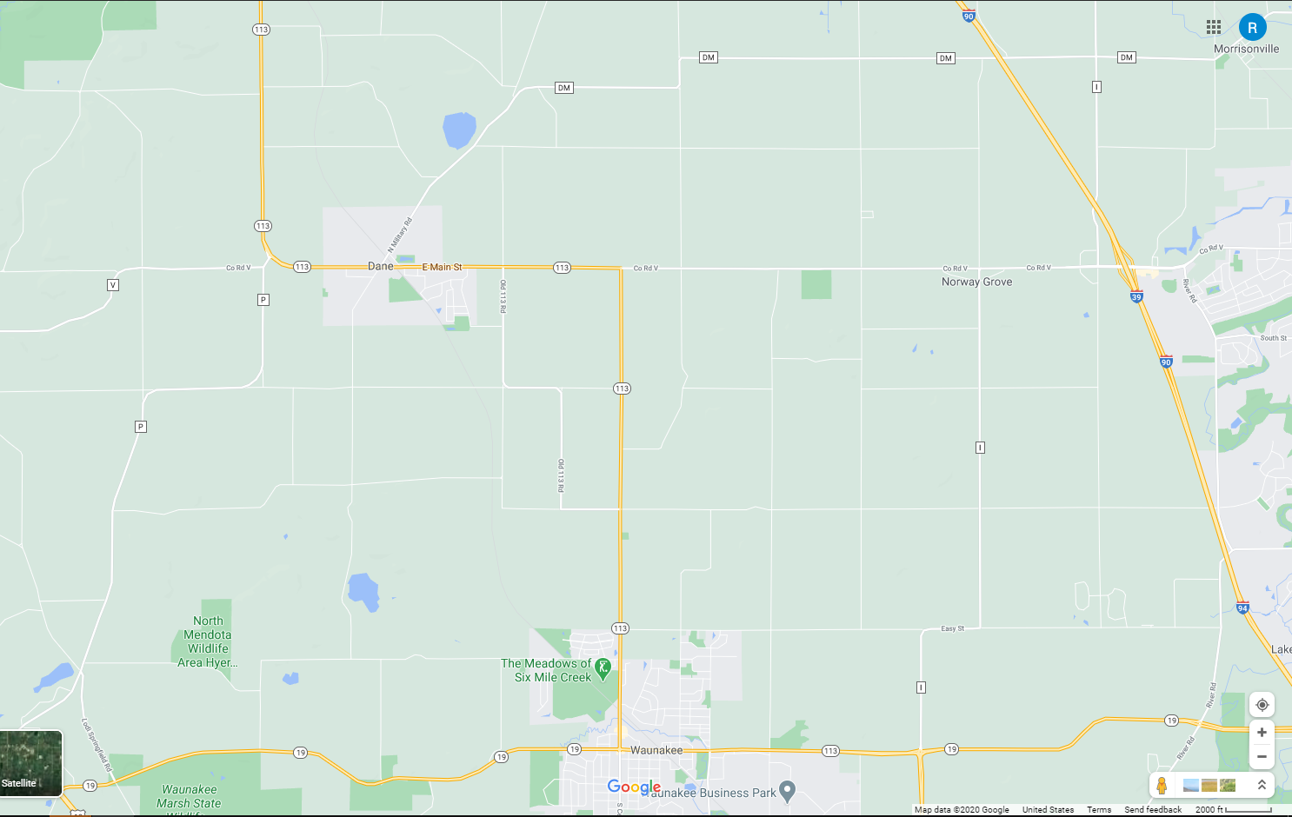
Motivation
Insights from more detailed terrain and land usage information: urban planning, land usage evaluation, natural resources efficiency

Slide 3
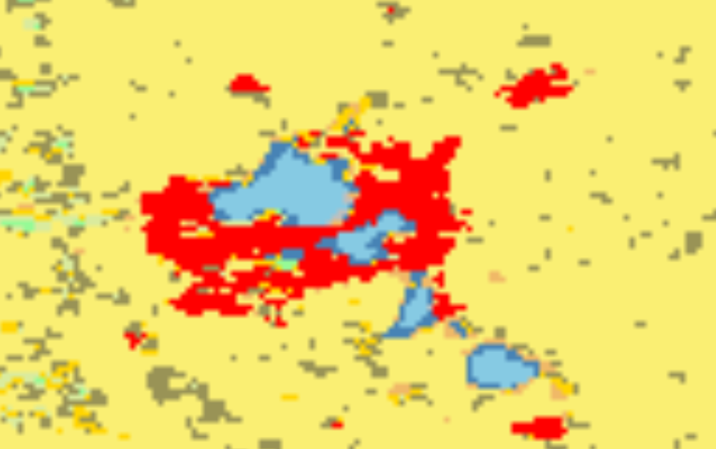
Existing Work
Specific tasks: deforestation rates, crop yield, flooding areas
Autoencoders, SVMs, CNNs
NASA’s Land Cover Type

Slide 4
Our approach
Semantic Segmentation
Only a portion of the state of Wisconsin
High resolution
Evaluate different Deep Neural Networks: U-Net and Deeplab V3+
Mapbox Static Images API (available for free)

Slide 5
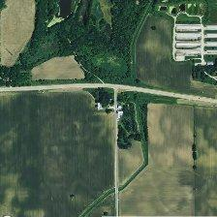
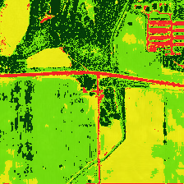
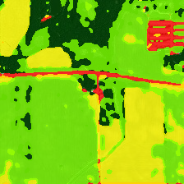
Labeling process
K-means clustering
Manual Linking
Gaussian Filter

Slide 6
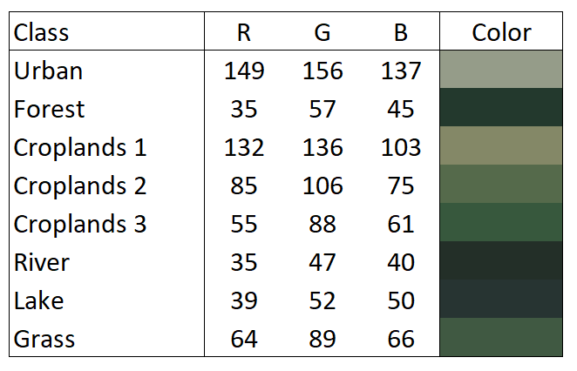
Baseline
Mean pixel value
Classify as most similar color
Very noisy
Very bad for similar classes (Croplands 3 and Grass, for example)

Slide 7

U-Net
Deep Convolutional Neural Network
Downsampling and Upsampling
Developed for biomedical image segmentation
Very popular in Image Segmentation problems

Slide 8
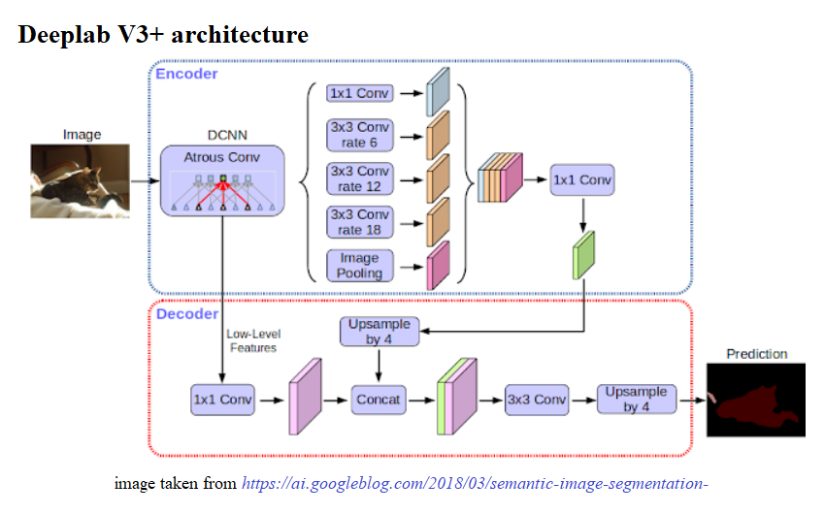
DeepLab V3+
Developed by Google in 2016
Great for segmenting foreground from background
Deep Convolutional Neural Network (DCNN) for Semantic Segmentation
Encoder-decoder network
Spatial pyramid pooling -> good for multi-scale
Atrous convolutions -> rates of 6, 12, and 18

Slide 9
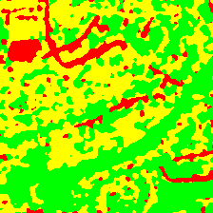
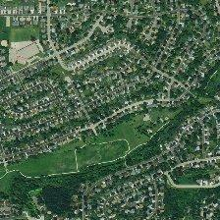
DeepLab Challenges
Model expects foreground vs. background
Satellite imagery does not have this
DCNNs typically require lots of labeled images
Typically 1,000 images per class
8 classes in our dataset
Only had 158 images labeled
DeepLab is slow without GPUs
Satellite image of a suburb -> no clear background

Slide 10
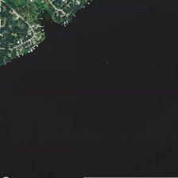
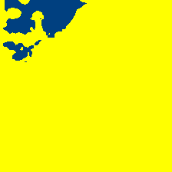
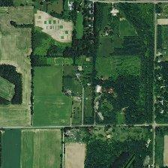
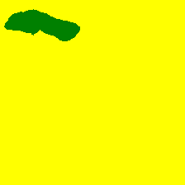
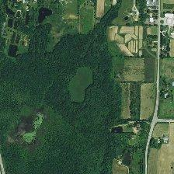
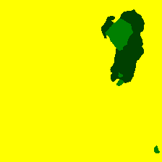
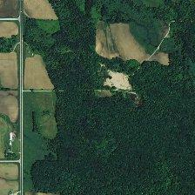
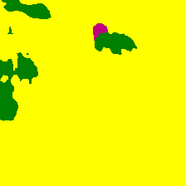
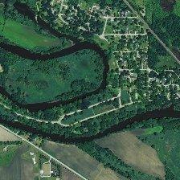
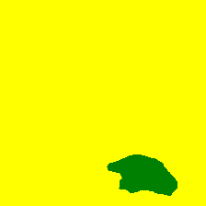
DeepLab Results
DeepLab deeply struggles in segmentation of satellite imagery
Mean Intersection over Union (mIOU) of 0.33

Slide 11
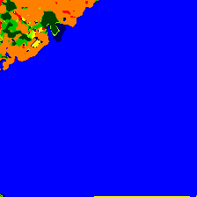
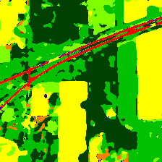
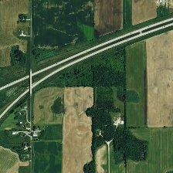
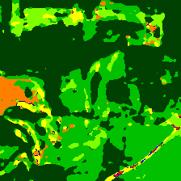
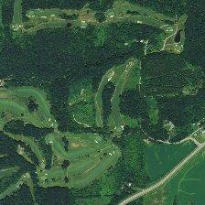
U-Net Results

Slide 12
U-Net and Mean Pixel Results - Dice
Label | Mean Pixel | U-Net
Urban | 0.24 | 0.53
Forest | 0.28 | 0.74
Croplands 1 | 0.47 | 0.76
Croplands 2 | 0.33 | 0.49
Croplands 3 | 0.45 | 0.62
River | 0.06 | 0.05
Lake | 0.04 | 0.92
Grass | 0.20 | 0.30
Total | 0.31 | 0.62
The Sørensen–Dice coefficient is a measure of similarity between 0-1, with 1 being perfect correctness
U-Net significantly better at classifying in all categories except for river
U-Net struggles to classify rivers, grass, and croplands 2
The U-Net confusion matrix suggests that the following were mistaken frequently:
Urban vs Croplands 1
Grass vs Forest
Croplands 2 vs Croplands 3
River vs Forest

Slide 13
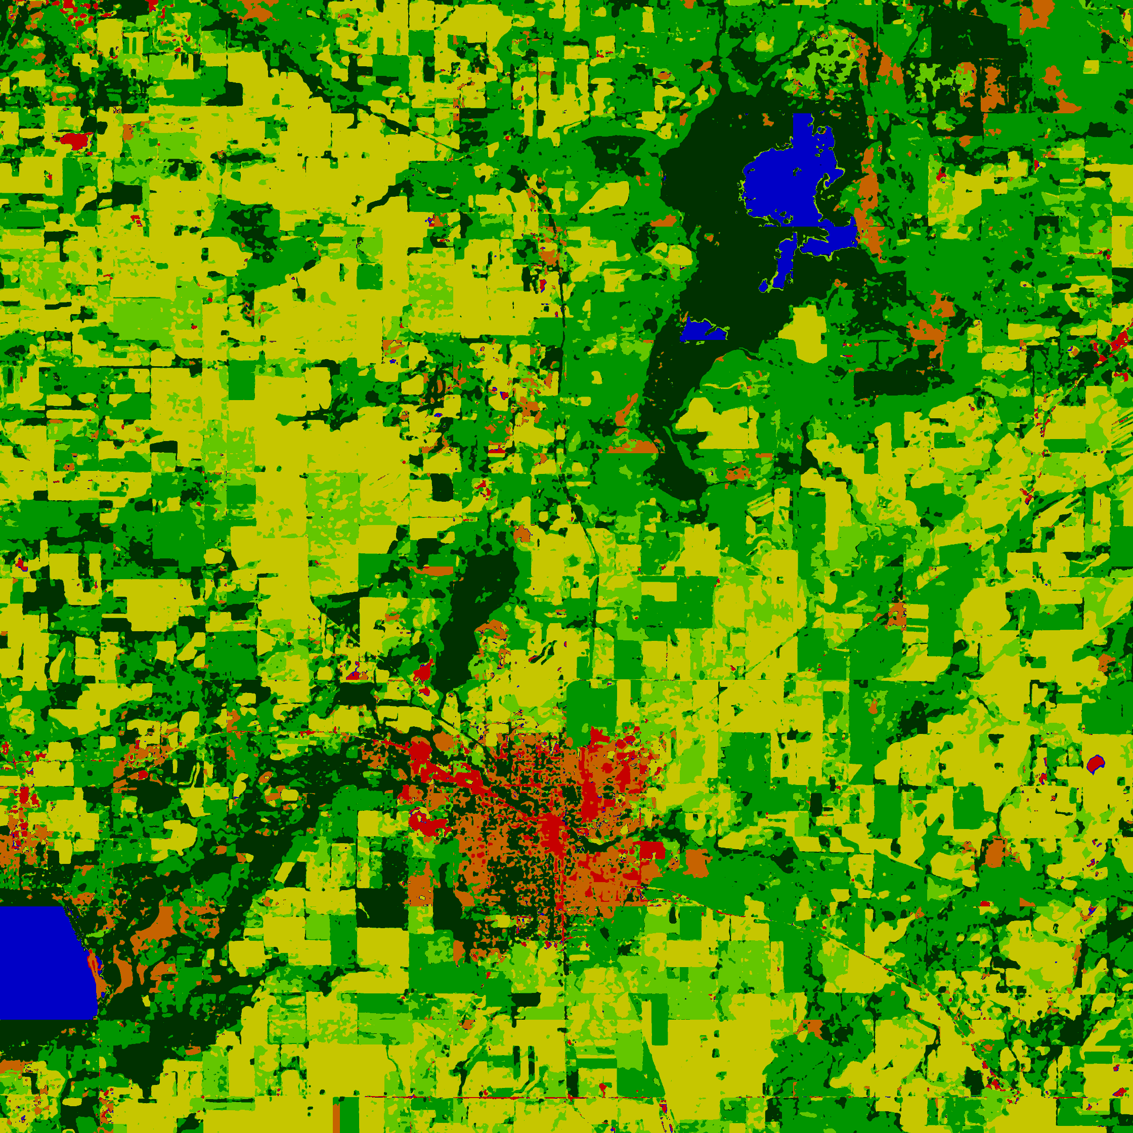
Thanks!
Contact us:
referreira@wisc.edu
simtiaz@wisc.edu

Slide 14
References
The Pascal Visual Object Classes Challenge – A Retrospective,
Mark Everingham, S. M. Ali Eslami, Luc Van Gool, Christopher K. I. Williams, John Winn, and Andrew Zisserma.
[link]. IJCV, 2014.
Encoder-Decoder with Atrous Separable Convolution for Semantic Image Segmentation,Liang-Chieh Chen and Yukun Zhu and George Papandreou and Florian Schroff and Hartwig Adam
Xception: Deep Learning with Depthwise Separable Convolutions François Chollet [link]. In CVPR, 2017.
Deformable Convolutional Networks -- COCO Detection and Segmentation Challenge 2017 Entry Haozhi Qi, Zheng Zhang, Bin Xiao, Han Hu, Bowen Cheng, Yichen Wei, Jifeng Dai [link]. ICCV COCO Challenge Workshop, 2017

